Slide 1

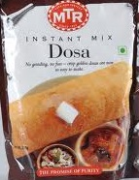
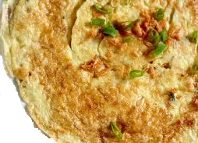
Dosa
Friend Suggestion
MTR Ready Mix
Requirement
Design Patterns
Frameworks
Scenario 1
Scenario 2
Scenario 3
Normal Way of Development
Development using Design Patterns
Development using Frameworks
With lot of R&D
she prepared
Dosa for the first time
She took the help of her
friend, where she had 5+
years of exp. in marital life
Now a days whenever she
wants to prepare the Dosa she
just brings the MTR Ready mix
& prepares it
My Wife
Time taken is More
Effort is More
Quality is Average
or Poor
Time taken is More
Effort is More
Quality is Good
Time taken is Less
Effort is Less
Quality is Good or
Very Good
Developer

